Slide 1
Tracheotomy
By : Ala’ Fuad Za’atreh

Slide 2
Definition
A surgical procedure by which an incision is made on the anterior aspect of the neck ,opening a direct airway through the trachea.
# tracheotomy Vs. tracheostomy. *
# tracheotomy Vs. endotracheal intubation.
Notes:
- A tracheotomy is generally described as a procedure that involves opening
the trachea. A tracheostomy is a procedure that
exteriorizes the trachea to the cervical skin, resulting in
a more permanent tracheal cutaneous fistula; therefore,
the term tracheostomy should be reserved for these particular
procedures.

Slide 3
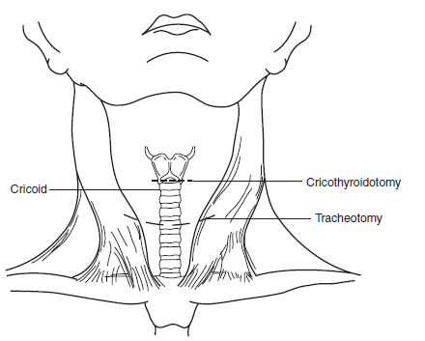

Slide 4
Indications
Conditions causing upper airway obstruction.
Conditions necessitating protection of the tracheo-bronchial tree.
Conditions causing respiratory failure.

Slide 5
1.Conditions causing upper airway obstruction:
Congenital
Trauma
Subepiglotic or upper tracheal stenosis.
Laryngeal web.
Laryngeal and vallecular cysts.
Tracheo-oesophageal anomalies.
Haemangioma of larynx .
Prolonged endotracheal intubation.
Gun shot wounds and cut throat , laryngeal fracture.
Inhalation of steam or hot vapour.
Swallowing of corrosive fluids.
Radiotherapy.
Notes:
laryngeal web a common congenital malformation of the larynx, ranging from a thin, translucent diaphragm to a thicker, more fibrotic
obstruction; it is spread between the vocal folds near the anterior commissure and may cause hoarseness, aphonia, and other symptoms.
Vallecular Cyst
Salivary retention cysts, such as vallecular cysts or saccular cysts, can be confused with endolaryngeal lymphatic cysts. Laser excision can be performed with removal of the cyst lining. Recurrence is rare if the lining is removed.

Slide 6
Cont..Conditions causing upper airway obstruction:
Infections
Malignant Tumors
Acute epiglottis
Laryngotracheobronchitis
Diphtheria
Ludwig’s angina
Advanced malignant disease of the tongue,larynx.pharynx or upper trachea
As part of surgical treatment of laryngeal cancer
Carcinoma of thyroid.
Notes:
is a serious, potentially life-threatening cellulitis^{[1]}, or connective tissue infection, of the floor of the mouth, usually occurring in adults- -Ludwig’s angina

Slide 7
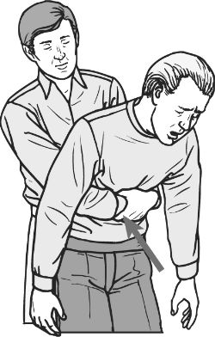
Cont..Conditions causing upper airway obstruction:
Bilateral laryngeal paralysis
Foreign body
Heimlich maneuver
Following thyroidictomy .
Bulbar palsy.
Following oesophageal or heart surgery.

Slide 8
2-Conditions necessitating protection of the tracheo-bronchial tree:
Any condition causing pharyngeal or laryngeal incompetence may allow aspiration of food, Saliva, blood or gastric content..
It allows easy access to the trachea and bronchi for regular suction, and permit the use of a cuffed tube which affords further protection against aspiration.

Slide 9
Cont..Conditions necessitating protection of the tracheo-bronchial tree:
Polyneuritis
Bulbar poliomyelitis
Multiple sclerosis
Coma
Myasthenia gravis
Tetanus
Brain stem stroke
8. Multiple facial fractures
9. Coma due to( stroke, head injury, poising, cerebral trauma)
Unless the state of coma is likely to be prolonged, endotrachial intubation is preferable in the first place..
Notes:
Polyneuritis is an inflammation of multiple nerves at once. It can appear as a complication of a number of different medical conditions, and also on its own in some cases
One example of polyneuritis is acute idiopathic polyneuritis, also known as Guillain-Barre syndrome. In this condition, the immune system starts to attack the myelin which sheathes the nerves in response to stress. Guillain-Barre can appear in response to some vaccinations, although this is rare, and it can also occur as a complication of disease.

Slide 10
3.Conditions causing respiratory failure:
Respiratory failure is a multi-factorial, main headings:
I-Pulmonary disease: exacerbation of chronic bronchitis and emphysema, sever asthma, post-operative pneumonia.
II-Abnormalities of the thoracic cage: severe chest injury, ankylosing spondylities, severe kyphosis.
III-Neuromuscular dysfunction: Like Guillain-Barre syndrome, tetanus, motor neuron disease, poliomyelitis.

Slide 11
Cont..Conditions causing respiratory failure:
In this case tracheotomy allows:
Reduction of dead space (70ml).
Bypass of laryngeal resistance.
Access to the trachea for the removal of bronchial secretion.
Administration of humidified Oxygen.
Positive -pressure ventilation when necessary.

Slide 12
Reasons for avoiding tracheotomy in children
# most cases of respiratory obstruction are infective in origin & will resolve sufficiently within 72 hrs to allow extubation.
# a tracheotomy is more hazardous to perform, due to a short neck, the presence of the thymus & a high bracheocephalic artery.
# removal of a tracheostomy tube is difficult in children due to development of subglottic edema with granulations.

Slide 13
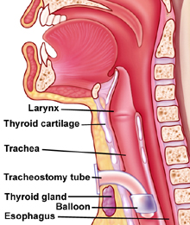

Slide 14
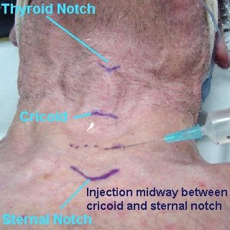
The operation of elective :tracheotomy – procedure:
# before tracheotomy , ensure that the cricoid cartilage & 1st trachial ring are not
compromized .
# Landmarks such as the thyroid notch, the cricoid,
the sternal notch, and planned incisions are
marked.
Notes:
* Otherwise , there is a high risk of late subglottic stenosis.

Slide 15
1) Horizontal skin Incision centered midway between the cricoid cartilage and the sternal notch.*
2) Strap muscles exposed and separated in midline.
3) Strap muscles separated to expose thyroid isthmus, which is usually divided and ligated.
4) Trachea exposed . A fenestra is created by excising anterior tracheal rings (b/w 2nd & 3rd OR 3rd & 4th ). A simple vertical incision is used in children.
5) The opening in the trachea is ready to take the appropraite diameter tracheotomy tube.
Notes:
* The incision is then
infiltrated with a local anesthetic containing epinephrine
to help decrease bleeding

Slide 16
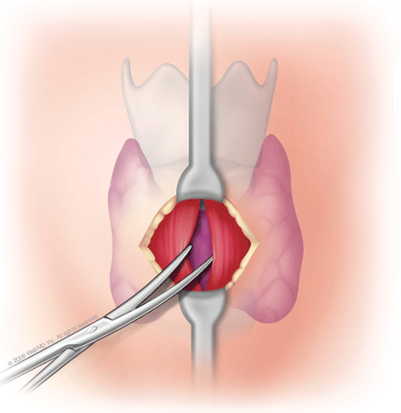
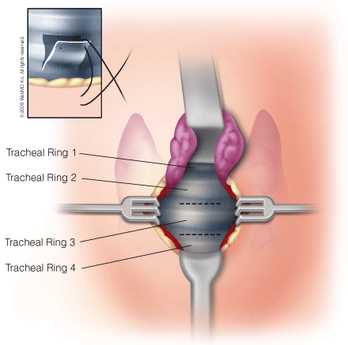
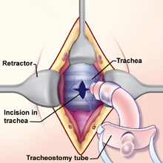

Slide 17
Percutaneous Tracheotomy
This is the most commonly used technique in critical care as it is simple and quick, can be performed at the bedside using anesthetic sedation and local anesthetic, and therefore is often the technique of choice in the critically ill. The procedure involves the insertion of a needle through the neck into the trachea followed by a guide-wire through the needle. The needle is removed and the tract made gradually larger by inserting a series of progressively larger dilators over the wire until the stoma is large enough to fit a suitable tube (Seldinger technique). This is then secured by cloth ties or a holder.

Slide 18
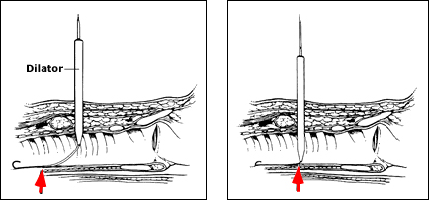

Slide 19
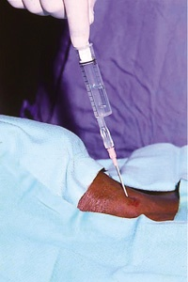
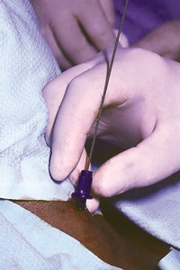
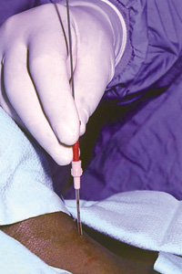
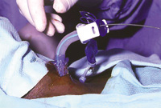

Slide 20
Relative contraindications
age under 15 years of age; uncorrectable bleeding diathesis; gross distortion of the neck from hematoma, tumor, thyromegaly, or scarring from previous neck surgery; documented or clinically suspected tracheomalacia; evidence of infection in the soft tissues of the neck; obese and/or short neck which obscures landmarks; and inability to extend the neck because of cervical fusion, rheumatoid arthritis, or other causes of cervical spine instability

Slide 21
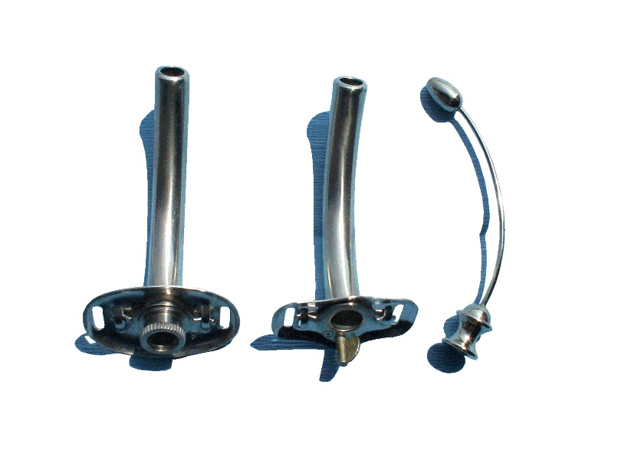
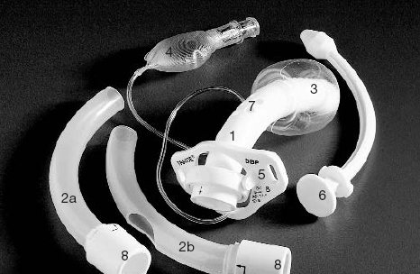
Types of Tracheostomy Tubes:
Tracheostomy tubes can be made of metal, plastic or silicone. Plastic and silicone tubes are increasingly popular because they are lightweight and there is less crusting of secretions.

Slide 22
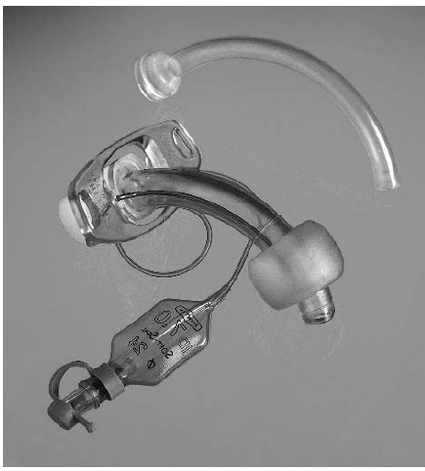
Types of Tracheostomy Tubes:
>>Cuffed Tracheostomy Tube:
Indications
 Risk of aspiration.
 Newly formed stoma(adult).
 Positive pressure ventilation.
 Unstable condition.
Contraindications
-Child less than 12 years of age..
-Significant risk of tracheal tissue damage from cuff..

Slide 23
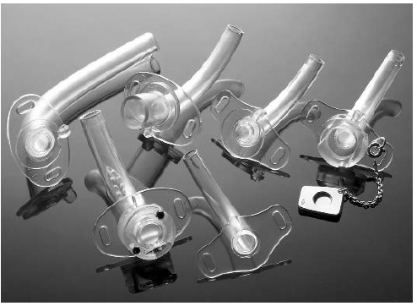
Types of Tracheostomy Tubes:
>>Uncuffed Tracheostomy Tube:
Indications
Vocal cord palsy.
 head and neck tumor.
Respiratory insufficiency.
 Neuromuscular disorders.
Pediatric or neonatal tracheostomy.
Contraindications
- Dependant on positive pressure ventilation.
-significant risk of aspiration.
-Newly formed tracheostomy.

Slide 24
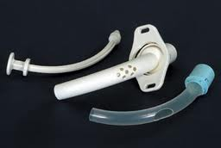
Types of Tracheostomy Tubes:
>>Fenestrated Tracheostomy Tube
Fenestrations refer to the holes in the lumen of the tracheostomy tube.These can be several small holes or one large hole, this enables normal breathing and the ability to speak or cough through the mouth.
Fenestrated tracheostomy tubes are recommended to help wean some patients from their temporary tracheostomy tube.
May cause fibrous tissue to develop along the tracheal wall near the fenestrations.

Slide 25
POSTOPERATIVE CARE
1) Humidifying inspired air is necessary to
prevent crusting and tracheitis.
2) Suctioning the tube and trachea on a frequent basis immediately postoperatively. *
3) Chest physiotherapy assists in bronchial toilet.
4) changing the tracheotomy tube can usually be performed at 3-5 days, after an adequate tract has formed.
Notes:
* is necessary to clear secretions and prevent plugging. The frequency of suctioning can be decreased as the postoperative time increases and the patient recovers.

Slide 26
DECANNULATION
1) the disease process that resulted in the need for a tracheotomy must be resolved.
2) Good airway patency allows for successful decannulation. *
3) tube removal is usually performed after 24 hours of tube occlusion.
Notes:
* Patency can be evaluated either with a mirror exam of the larynx or by direct fiberoptic endoscopy.

Slide 27
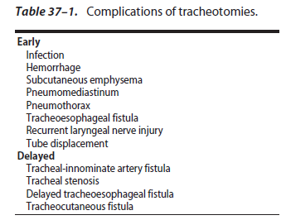

Slide 28
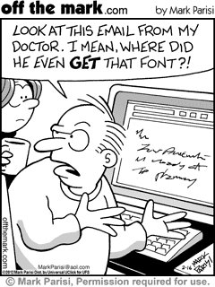
Thank you ☺

