Slide 1
STRIDOR
by Akmal Asyiqien Adnan

Slide 2
DEFINITION
Stridor is a harsh noise produced by turbulent airflow through a partially obstructed airway at the level of the supraglottis, glottis, subglottis and/or trachea.
It should be differentiated from stertor, which is a lower-pitched, snoring-type sound generated at the level of the nasopharynx, oropharynx & occasionally supraglottis.
Stridor is a symptom, not a diagnosis or disease, and the underlying cause must be determined.

Slide 3


Slide 4
GENERAL RULE
Inspiratory stridor suggests a supraglottis and glottis obstruction.
Expiratory stridor implies tracheal obstruction
Biphasic stridor suggests a subglottis obstruction.

Slide 5
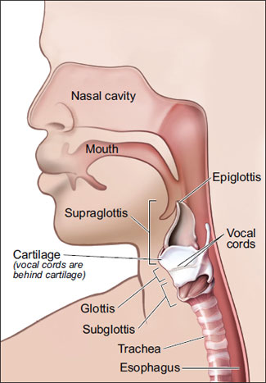

Slide 6
CAUSES OF ACUTE STRIDOR
Acute laryngotracheobronchitis (croup)
Acute epiglottitis (supraglottitis)
Foreign body aspiration
Allergic reaction
Acute tracheiatis

Slide 7
CAUSES OF CHRONIC STRIDOR
Laryngomalacia
Vocal vord paralysis
Laryngeal cyst
Laryngeal webs
Posterior laryngeal cleft
Subglottic hemangiomas
Laryngeal papilloma

Slide 8
CLINICAL APPROACH
History
Physical examination
Investigation
Management

Slide 9
HISTORY
Age of onset, duration, severity, progression, precipitating events (crying, feeding)
Quality and nature of crying
Positioning ( prone, supine, sitting)
Voice
Associated symptoms (cough, aspiration, difficulty feeding, drooling, sleep disordered breathing)
Elicit history of color change, cyanosis, respiratory effort, and apnea to determine the severity of stridor.

Slide 10
PERINATAL:
Maternal endotracheal intubation use and duration
Congenital anomalies
Developmental history
Feeding and growth history should be evaluated because significant airway obstruction can lead to caloric waste, resulting in lack of or slow weight gain and growth.
Regurgitation and spitting up could be a sign of GER that can cause irritation of the mucosa of the larynx and trachea that could lead to edema and stridor.

Slide 11
Systemic review – ENT, RS, CVS, GI, CNS
Past medical
Family history
Drugs history
Social history

Slide 12
EXAMINATION
Any procedures that may induce anxiety (throat examination, venipuncture etc) should NOT be undertaken as it may cause complete airway obstruction.
General look
Vital signs
Routine full examination (RS, CVS, GI etc)

Slide 13
INVESTIGATION
Laboratory Studies
Pulse oximetry
arterial blood gas
Imaging Studies
AP & lateral radiographs of the neck and chest (steeple sign, thumb print sign)
Barium esophagram may be performed if vascular compression, tracheoesophageal fistula, GER, or neurological dysfunction is suspected.
Contrast-enhanced CT scanning can demonstrate mediastinal masses or aberrant vessels.
MRI may be helpful in delineating lesions of the upper airway and vascular anomalies.
PH probe or barium swallow, If GER is suspected.
Other Tests
Endoscopy
Laryngobronchoscopy

Slide 14
MANAGEMENT
Medical Care
According to the underlying or predisposing condition.
Emergent management consists of ensuring that the airway is adequate.
If not, appropriate resuscitative measures must be initiated.
Some conditions (epiglottitis, bacterial tracheitis) may require antibiotics, while steroids may be useful in other situations.
Surgical Care
Severe laryngomalacia, laryngeal stenosis, critical tracheal stenosis, laryngeal and tracheal tumors and lesions
Foreign body aspiration, require surgical correction.
Tracheotomy is used to protect the airway to bypass laryngeal abnormalities and stent or bypass tracheal abnormalities.
Retropharyngeal and peritonsillar abscess, may have to be dealt with on an emergent basis.
Moderate to severe stridor should be NPO in preparation for possible intubation, laryngoscopy, bronchoscopy, and tracheotomy.

Slide 15
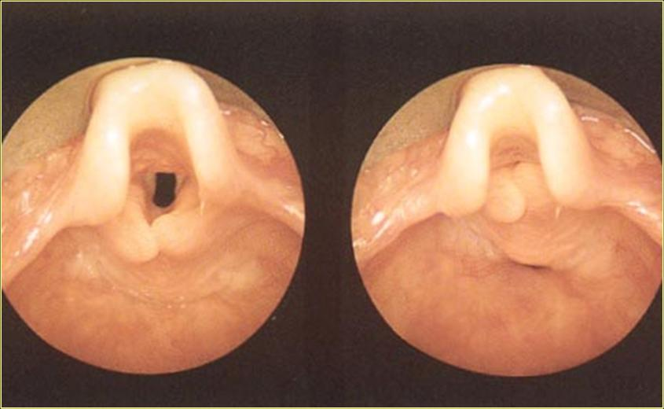
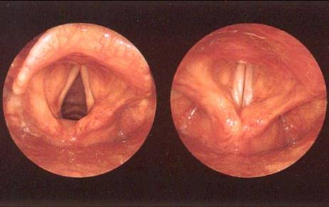
LARYNGOMALACIA
Laryngomalacia
Normal larynx

Slide 16
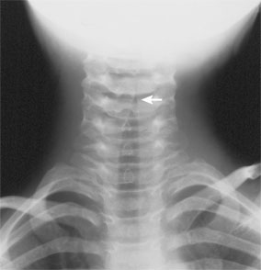
CROUP
Most common in 6m-3y
Parainfluenza virus
Barking cough, low-grade fever
Stridor, hoarseness of voice
Preceded by URTI
Steeple sign
Management :
-humidification of respiratory gases
-oxygen
-steroids
-nebulized epinephrine

Slide 17
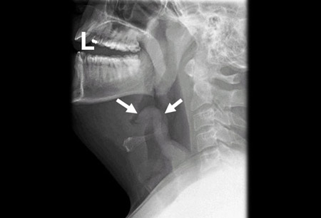
EPIGLOTTITIS
Typically in 2-6y/o
By H. Influenza
High mortality rate
Fever, difficulty in breathing, severe odynophagia
Muffled voice, inspiratory stridor
THUMB PRINT SIGN
Management:
-refer to ENT, Anest, Pediatrician
-transfer to room with tracheostomy available
-IV a/biotic (ceftriaxone)

