Slide 1
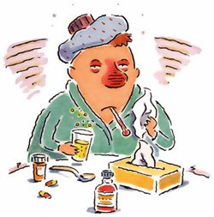
Rhino-sinusitis
Done By : Dina Shamaileh

Slide 2
Anatomy
The paranasal sinuses are a group of air containing spaces that surround the nasal cavity
Each sinus is name for the bone in which it is located:
Maxillary (one sinus located in each cheek)
Ethmoid (approximately 6-12 small sinuses per side, located between the eyes)
Frontal (one sinus per side, located in the forehead)
Sphenoid (one sinus per side, located behind the ethmoid sinuses, near the middle of the skull)

Slide 3
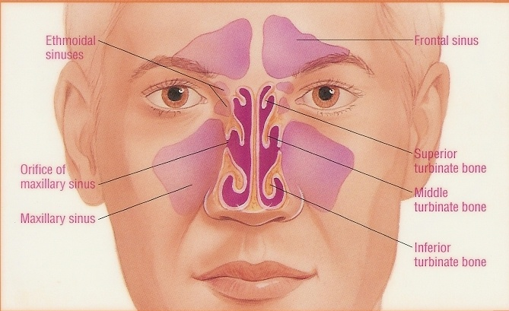
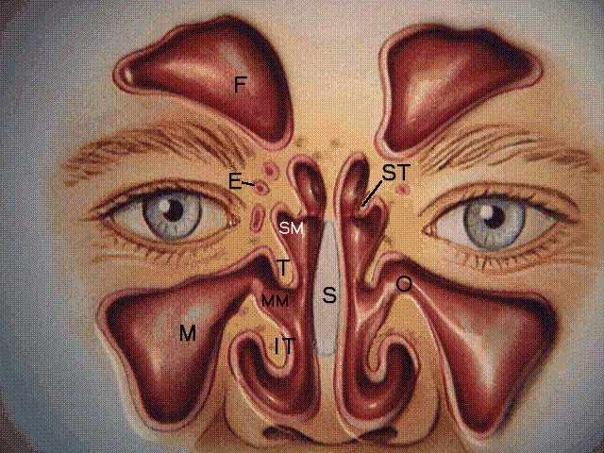

Slide 4
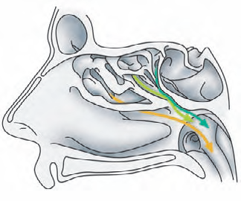
The drainage of the sinuses
Frontal, maxillary, anterior ethmiod → middle meatus
Posterior ethmoid → superior meatus
Sphenoid → sphenoethmoidal recess

Slide 5
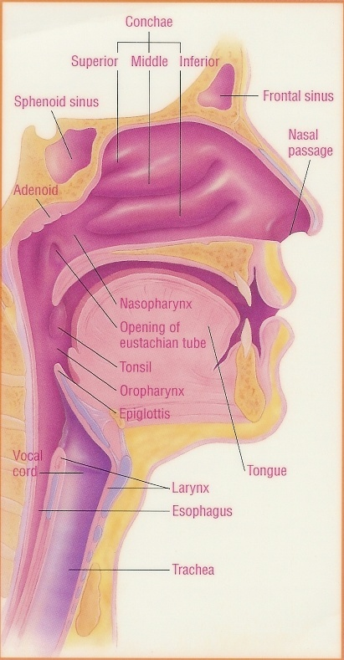
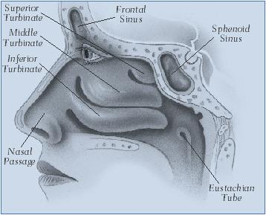

Slide 6
Development of sinuses
The Ethmoid sinuses are present at birth, reach adult size by age 12.
The Maxillary present at birth.
Frontal sinus rarely present at birth; usually not visible until age 2, great variability in size; congenitally absent in 5%
Sphenoid sinuses are rarely present at birth, usually seen around age 4.

Slide 7
Rhino-sinusitis
Rhino-sinusitis is an inflammatory process involving one or more of the paranasal sinuses that usually occurs after an allergic reaction or viral upper respiratory infection. In some cases, rhino-sinusitis may occur due to an increased production of bacteria on the surface of the sinus cavities.
Rhino-sinusitis and nasal polyps have many similarities. Rhino-sinusitis refers to the inflammation of the tissues of the nose (rhino-) and the sinuses. Nasal Polyps (tissue swellings) can form within the nose and sinuses, these are responsible for many symptoms described by patients with chronic rhino-sinusitis.

Slide 8
Etiology
  Viral (10-15%)
  Rhinovirus (most common viral sinusitis cause), Influenza, Parainfluenza, Adenovirus
  Bacterial
    Acute Sinusitis :Streptococcus Pneumoniae, Haemophilus Influenzae, Moraxella, Streptococcus Pyogenes
    Chronic Sinusitis:
      Anaerobes (>50%)
        Bacteroides, Anaerobic Gram Positive Cocci, Fusobacterium species
      Other less common causes
        Staphylococcus aureus, Hemophilus Influenzae, Pseudomonas aeruginosa, Escherichia coli, Beta-hemolytic Streptococcus, Neisseria causes
  Fungal (Immunocompromised or DM)
    Aspergillus, Mucormycosis…

Slide 9
Pathogenesis
Sinuses are normally sterile, but their proximity to nasopharyngeal flora allows bacterial and viral inoculation following rhinitis.
Diseases that obstruct drainage can result in a reduced ability of the paranasal sinuses to function normally. The sinus ostia become occluded, leading to mucosal congestion.
The mucociliary transport system becomes impaired, leading to stagnation of secretions and epithelial damage, followed by decreased oxygen tension and subsequent bacterial growth.

Slide 10
Symptoms of Rhino-sinusitis
These are the general signs and symptoms of Rhino-sinusitis:
Facial pain
Facial pressure
Nasal blockage
Discharge
Fever
Headaches
Halitosis
Fatigue
Cough
Ear pain/pressure/fullness
Malaise
Sore throat

Slide 11
Rhino-sinusitis can be divided into four subtypes and causes
may vary due to the type of the condition :
Acute Rhino-sinusitis
Acute rhino-sinusitis is an inflammatory condition of one or more of the para-nasal cavities that usually lasts up to four weeks. Acute rhino-sinusitis can range from acute viral rhinitis (the common cold) to acute bacterial rhino-sinusitis.
Acute rhino-sinusitis usually begins with a cold, which obstructs the sinuses and causes mucosal swelling which is usually followed by a bacterial sinus infection. Then the mucus glands start to secrete large amounts of mucus which fills this cavity.

Slide 12
Patients should also be aware about common environmental irritants that may aggravate their rhino-sinusitis such as:
Cigarette smoke
Dust mites
Pollen
Molds
Allergen avoidance is still the best way to manage an allergy problem.
A combination of two or all of the following conditions is a common symptom of acute rhino-sinusitis:
Sneezing
Running nose
Stuffy nose
Fever

Slide 13
Chronic Rhino-sinusitis
Chronic rhino-sinusitis is the inflammatory and infection that concurrently affects the nose and para-nasal sinuses. Chronic Rhino-sinusitis is a debilitating form of sinusitis that can lead to significant physical symptoms as well as substantial functional and emotional impairment.
Chronic Rhino-sinusitis may become extensively painful and the tissues of nose (rhino) may swell since this condition lasts for longer than 12 weeks. In chronic rhino-sinusitis, a long duration of the following symptoms is typical and may be present:
Nasal polyps
Cystic fibrosis
Nasal obstruction

Slide 14
Chronic Rhino-sinusitis may be caused by a variety of underlying conditions such as:
Viral growth
Bacterial growth (Bacterial rhino-sinusitis results when the inflammatory process allows for an increased production of bacteria, which in turn causes more
inflammation).
Fungal growth

Slide 15
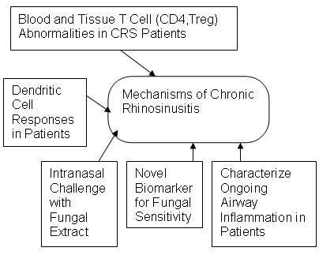

Slide 16
Recurrent acute Rhino-sinusitis
Recurrent acute rhino-sinusitis is defined when you have four or more recurrences of acute disease within a 12-month period, with resolution of symptoms between each episode. In most cases, each episode of recurrence lasts for at least seven days.

Slide 17
Sub acute Rhino-sinusitis
Sub acute rhino-sinusitis is basically a low-grade condition of an acute infection that lasts for more than four weeks, but less than 12 weeks. Sub-acute rhino-sinusitis usually involves one or two pairs of the paranasal cavities.
Though Sub acute rhino-sinusitis is regarded as a low grade condition, it may cause low productivity and discomfort.

Slide 18
:Treatment For Rhinosinusitis
Treatment for rhinosinusitis varies, and is usually based on the duration and severity of symptoms. If possible, a culture should be taken of nasal drainage to identify the cause of the illness. If your doctor's evaluation suggests that the infection is bacterial, antibiotics will be prescribed. Antibiotics will not be given for infections caused by viruses, since antibiotics will have no effect whatsoever on these infections.
Symptoms can be often similar regardless of the cause, and can be managed using a few different techniques, such as over-the-counter pain relievers (like acetaminophen or ibuprofen), decongestants (like pseudoephedrine), nasal irrigation, or topical steroids. Allergic rhinosinusitis is often treated with antihistamines as well.
In the case of chronic rhinosinusitis, sometimes endoscopic sinus surgery is necessary.
Untreated rhinosinusitis can impair your quality of life and lead to other conditions such as nasal polyps.

Slide 19
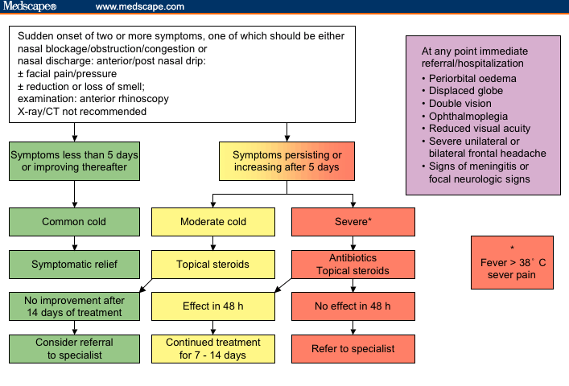

Slide 20
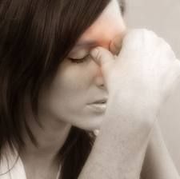
Chronic Sinusitis

Slide 21
Chronic Sinusitis
What is sinusitis?
Sinusitis means inflammation of a sinus. Most bouts of sinusitis are caused by an infection. The cheekbone (maxillary) sinuses are the most commonly affected
Chronic sinusitis: means that a sinusitis becomes persistent and lasts for longer than 12 weeks. Chronic sinusitis is uncommon.

Slide 22
How do you get chronic sinusitis?
Cold or flu-like illnesses
Dental infections
Other risk factors for sinus infection
  Allergic rhinitis (nose allergy)..
  Other causes of a blockage to the sinus drainage channels, such as nasal polyps, objects pushed into the nose (especially in children, such as peas or plastic beads), facial injury or surgery and certain
  congenital abnormalities.
  Asthma.
  Previous injury to the nose or cheeks.
  Cystic fibrosis.

Slide 23
Other risk factors for sinus infection
  A poor immune system - for example, people with HIV, people on chemotherapy, etc. A poor immune system makes you more prone to any infection. Fungal infections are rare causes of sinusitis and occur most commonly in people with a poor immune system.
  Inflammatory disorders such as Wegener's granulomatosis or sarcoidosis.
  Pregnancy, which makes you more prone to rhinitis (nasal inflammation).
  Primary ciliary dyskinesia/Kartagener's syndrome.
  Rare tumours of the nose.
  Smoking.
  Diabetes.
  Sniffing substances that irritate the lining of the nose (for example, cocaine).

Slide 24
What are the symptoms of chronic sinusitis?
The most prominent symptom is usually a blocked nose (nasal obstruction). One or more of the following may also occur:
A runny nose. The discharge may be greeny/yellow.
A reduced sense of smell.
Pain over the affected sinus. However, pain is often not a main feature of chronic sinusitis (unlike acute sinusitis). In many cases, it is more of a feeling of facial fullness or mild discomfort rather than pain.

Slide 25
Treatment
Antibiotics for 3 to 6 weeks for infectious etiology
  Augmented penicillin (Clavulin™)
  Macrolide (clarithromycin)
  Fluoroquinolone (levofloxacin)
  Clindamycin, FlagyjTM
Topical nasal steroid, saline spray
Surgery if medical therapy fails or fungal sinusitis
Surgical Treatment
  Removal of all diseased soft tissue and bone
  Post-op drainage
  Obliteration of pre-existing sinus cavity
FESS: functional endoscopic sinus surgery

Slide 26
Complications
Chronic sinusitis complications include:
Asthma flare-ups. Chronic sinusitis can trigger an asthma attack.
Meningitis, an infection that causes inflammation of the membranes and fluid surrounding your brain and spinal cord.
Vision problems. If infection spreads to your eye socket, it can cause reduced vision or even blindness that can be permanent.
Aneurysms or blood clots. Infection can cause problems in the veins surrounding the sinuses, interfering with blood supply to your brain and putting you at risk of a stroke.

Slide 27
THANK YOU !!!

